Slide 1
Character Recognition
MATLAB project

Slide 2
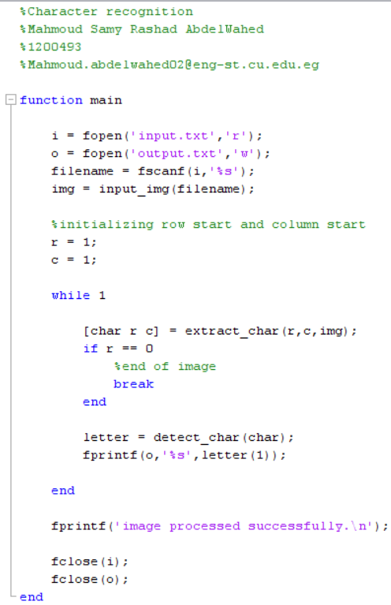
main.m
getting input and preparing for output
processing image:
extract character from image
detect character
output character
Notes:
general workflow of the program

Slide 3
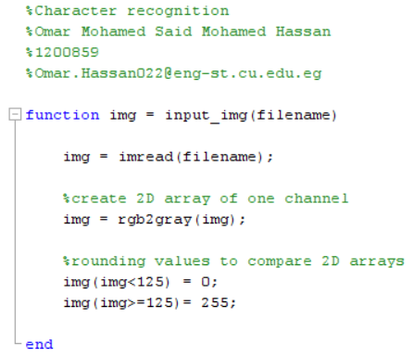
input_img.m
Reads the image from file (filename)
Converts the colour image RGB to the grayscale image
Returns an only black and white image with no shades

Slide 4
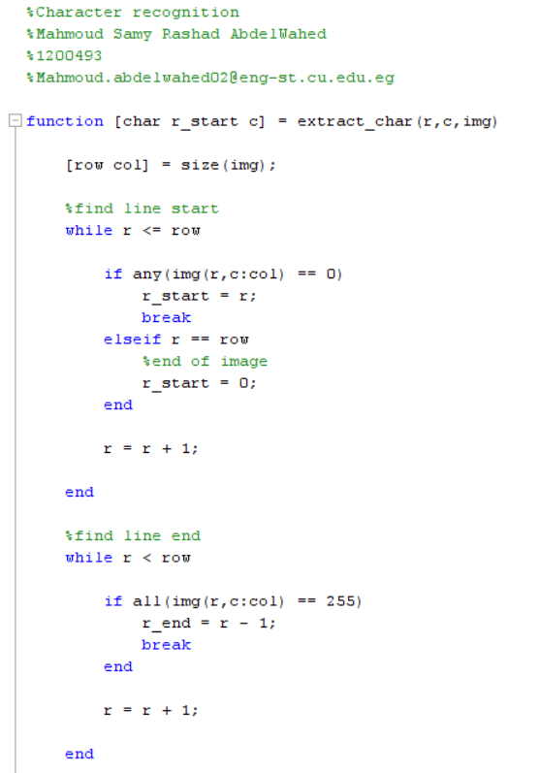

extract_char.m
r start
r
r end

Slide 5
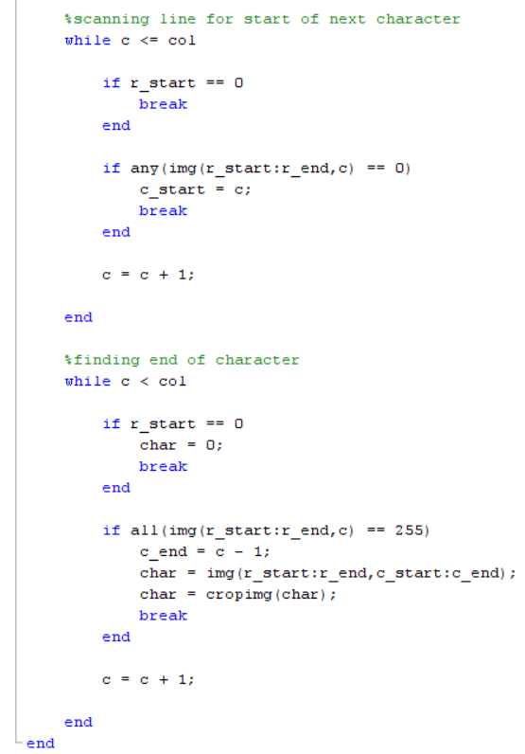

extract_char.m
c start
c
c end
char, r start, c returned to (main) function
reused as starting position when function is recalled
Notes:
Intersection of c and r start is starting position
r start = 0 is a flag used to that is used in main.m to end the program

Slide 6
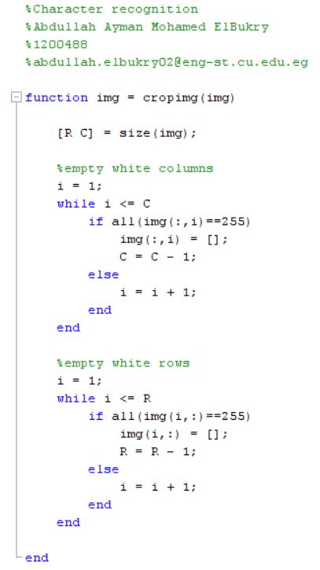

cropimg.m
Notes:
1. Returns the number of rows and columns in the image to variables R and C respectively
2. Checks if there are ‘white’ columns in the image. If present, the said column is ‘emptied’
3. The same process is repeated for the rows

Slide 7
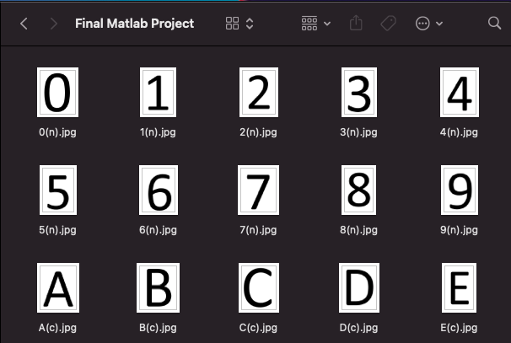
Database Folder

Slide 8
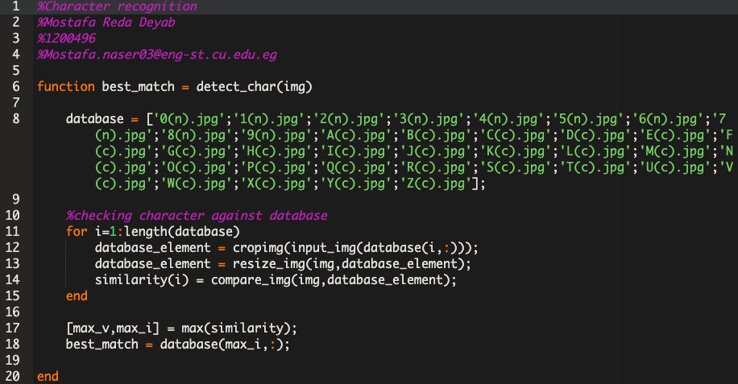
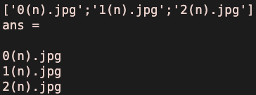

detect_char.m
Takes the filename then finds the image file to be read then cropped.
Resize the matrices to be equal.
Takes the matrices then it stores the percentage similarity between them in 1D array.

Slide 9
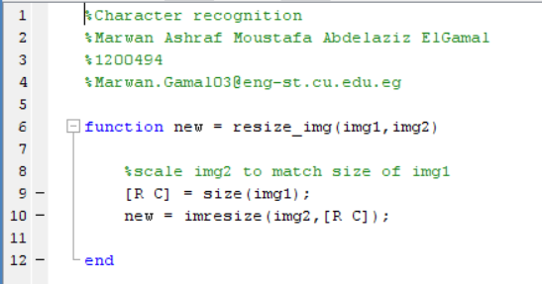
resize_img.m
Scales image 2 to match the size of image 1 in order to be able to compare them in compare_img

Slide 10
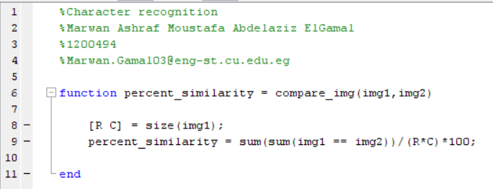
compare_img.m
returns a 2d array with either a 1 or a 0 (true or false respectively)
Returns a 1d array, where each element is the sum of all values in each column
Adds all the columns together giving a single value which shows how many elements are matching in both arrays (either 255 or 0)

Slide 11
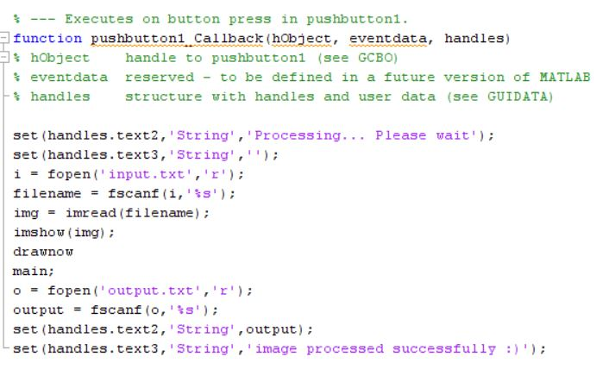
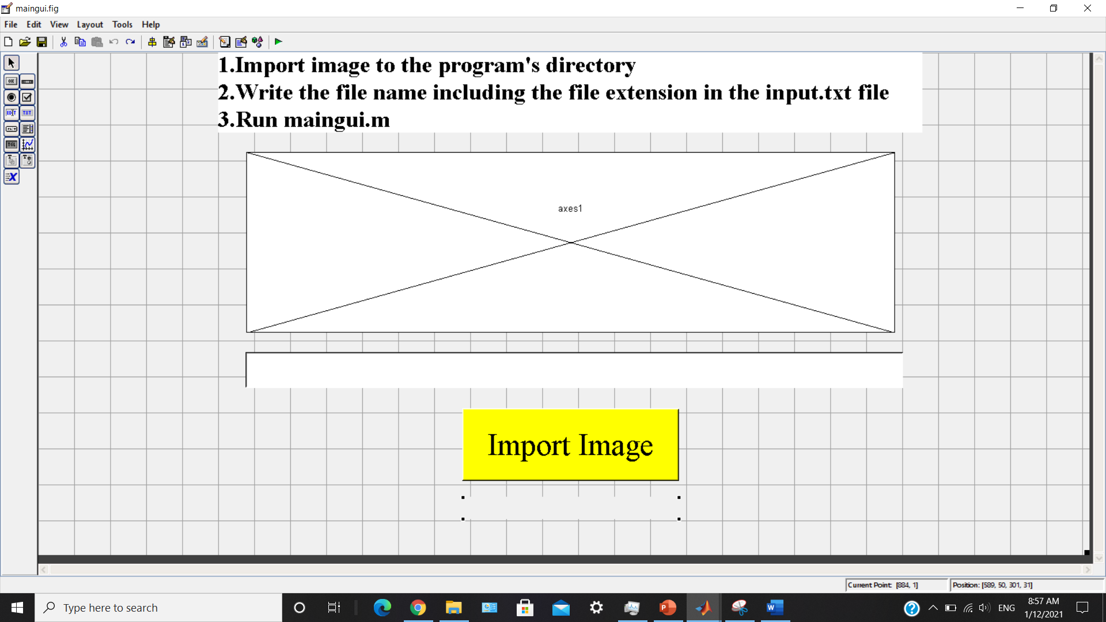
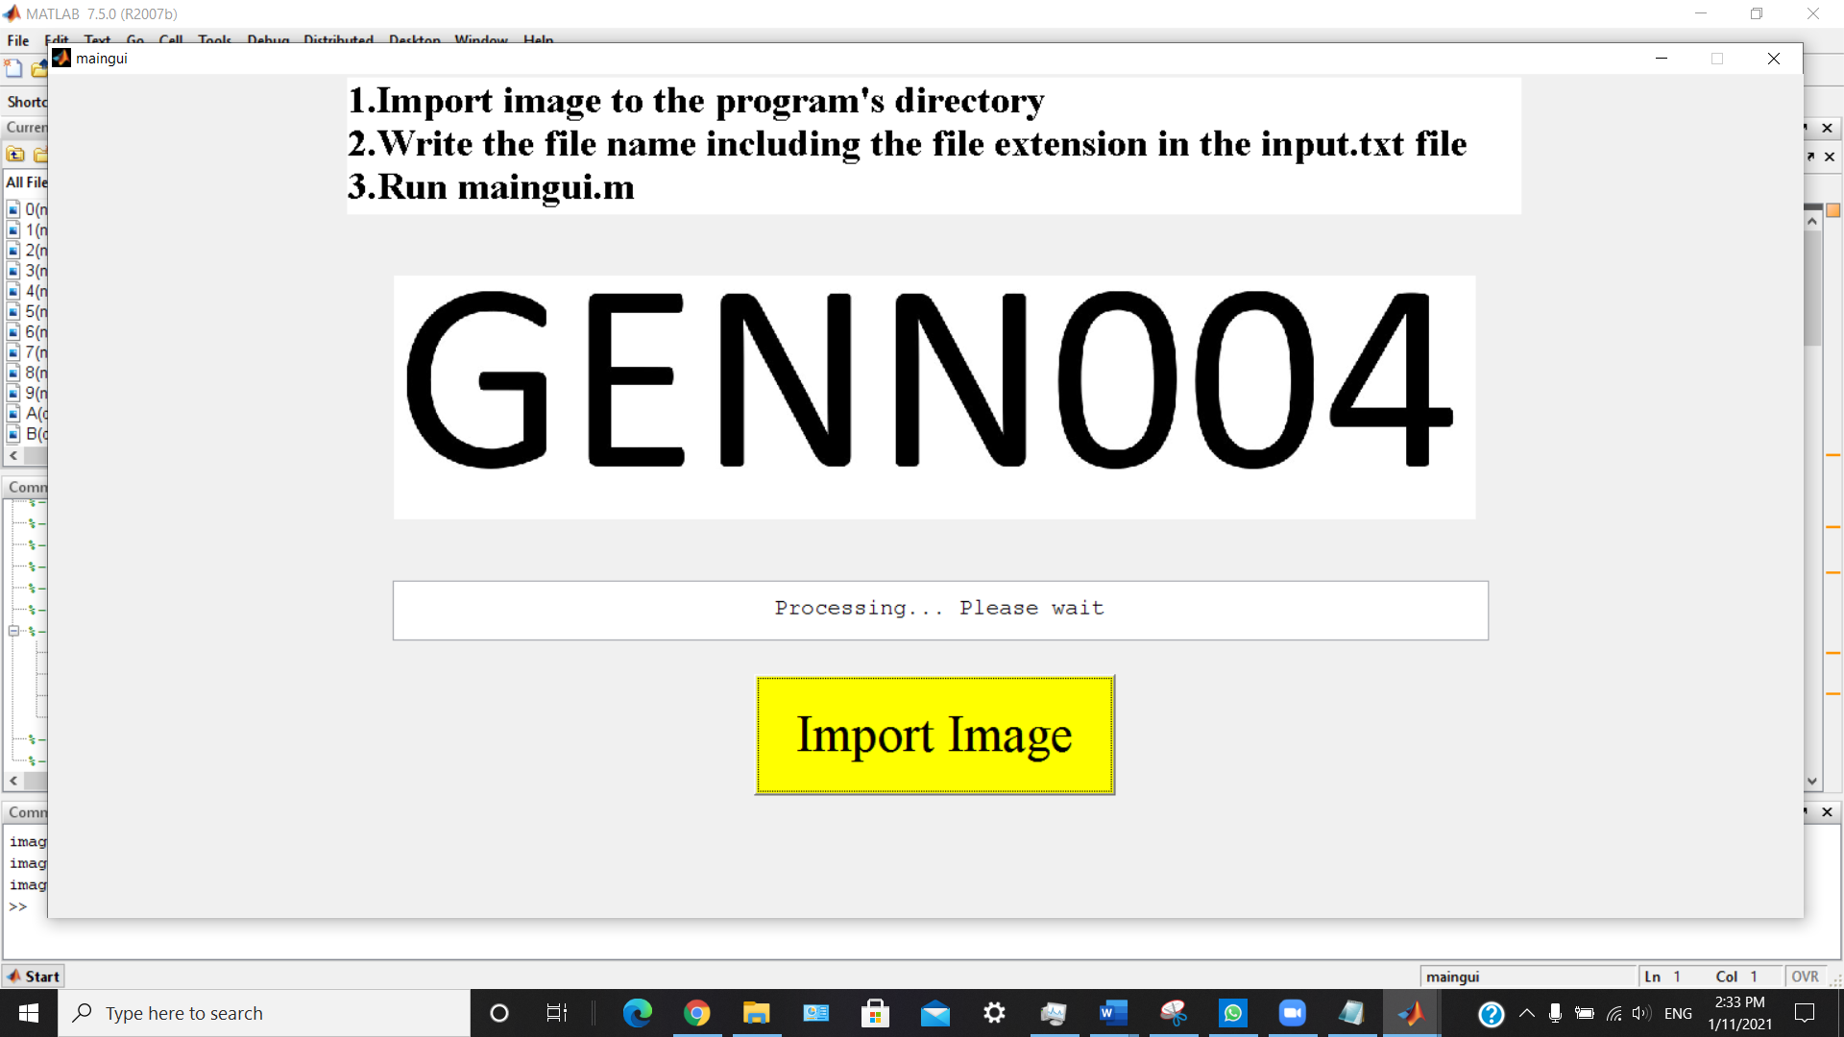
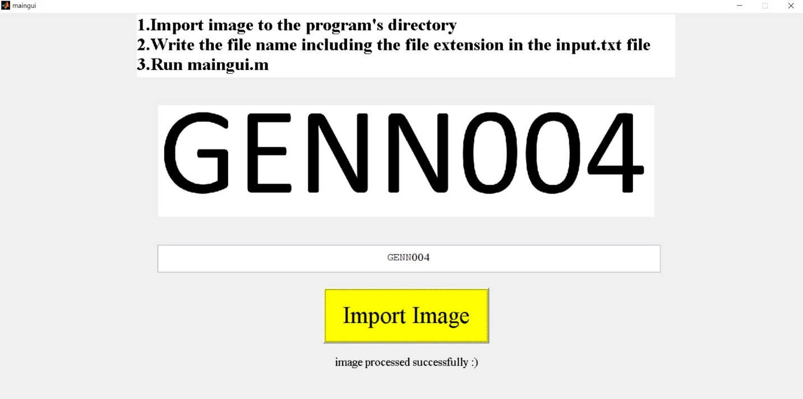
maingui.m
text2
pushbutton1
text3

